Slide 3
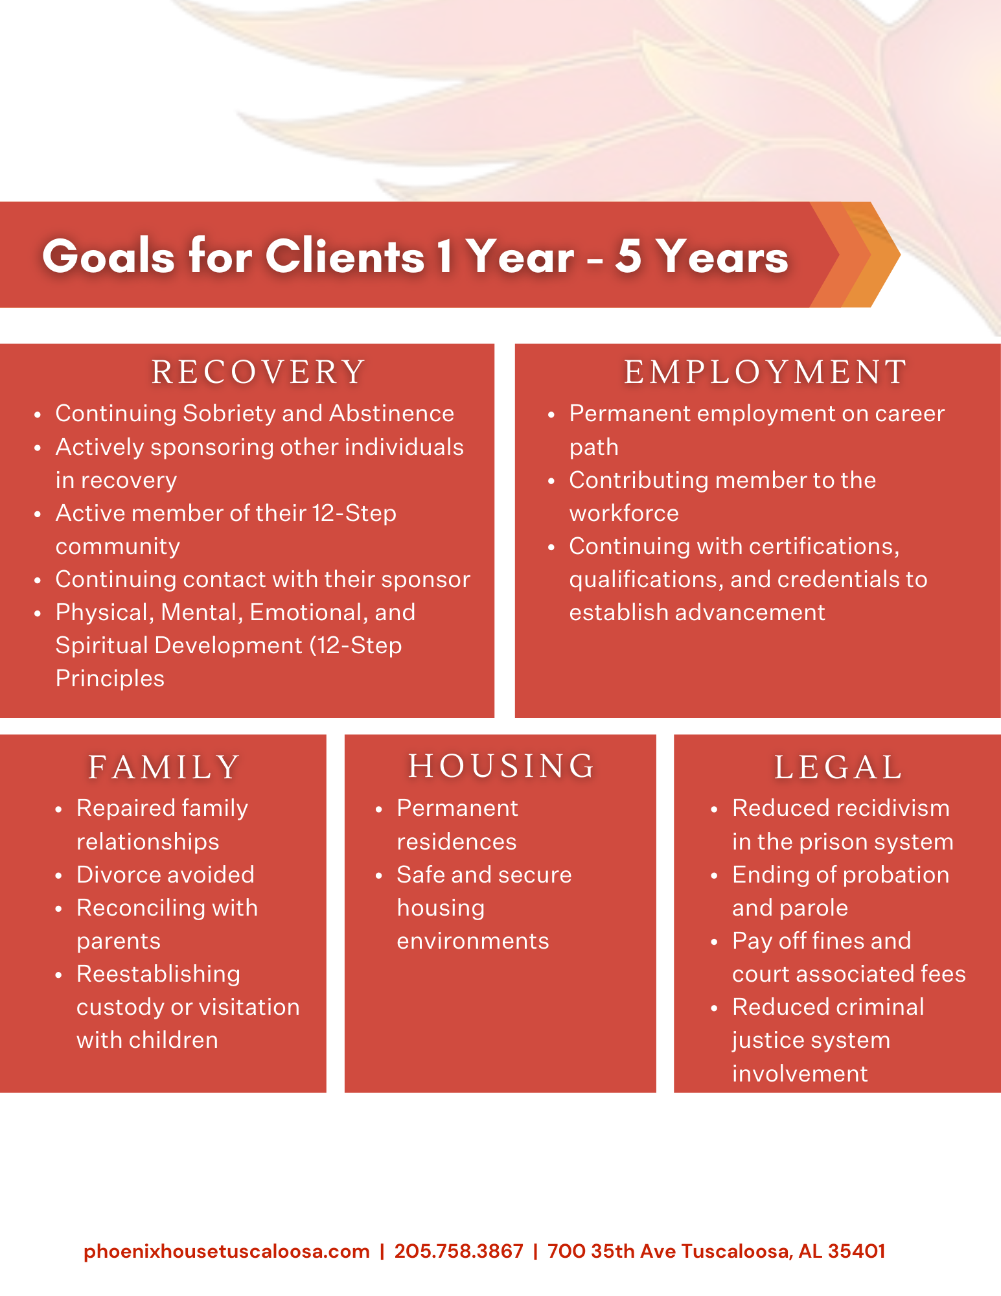

Slide 5
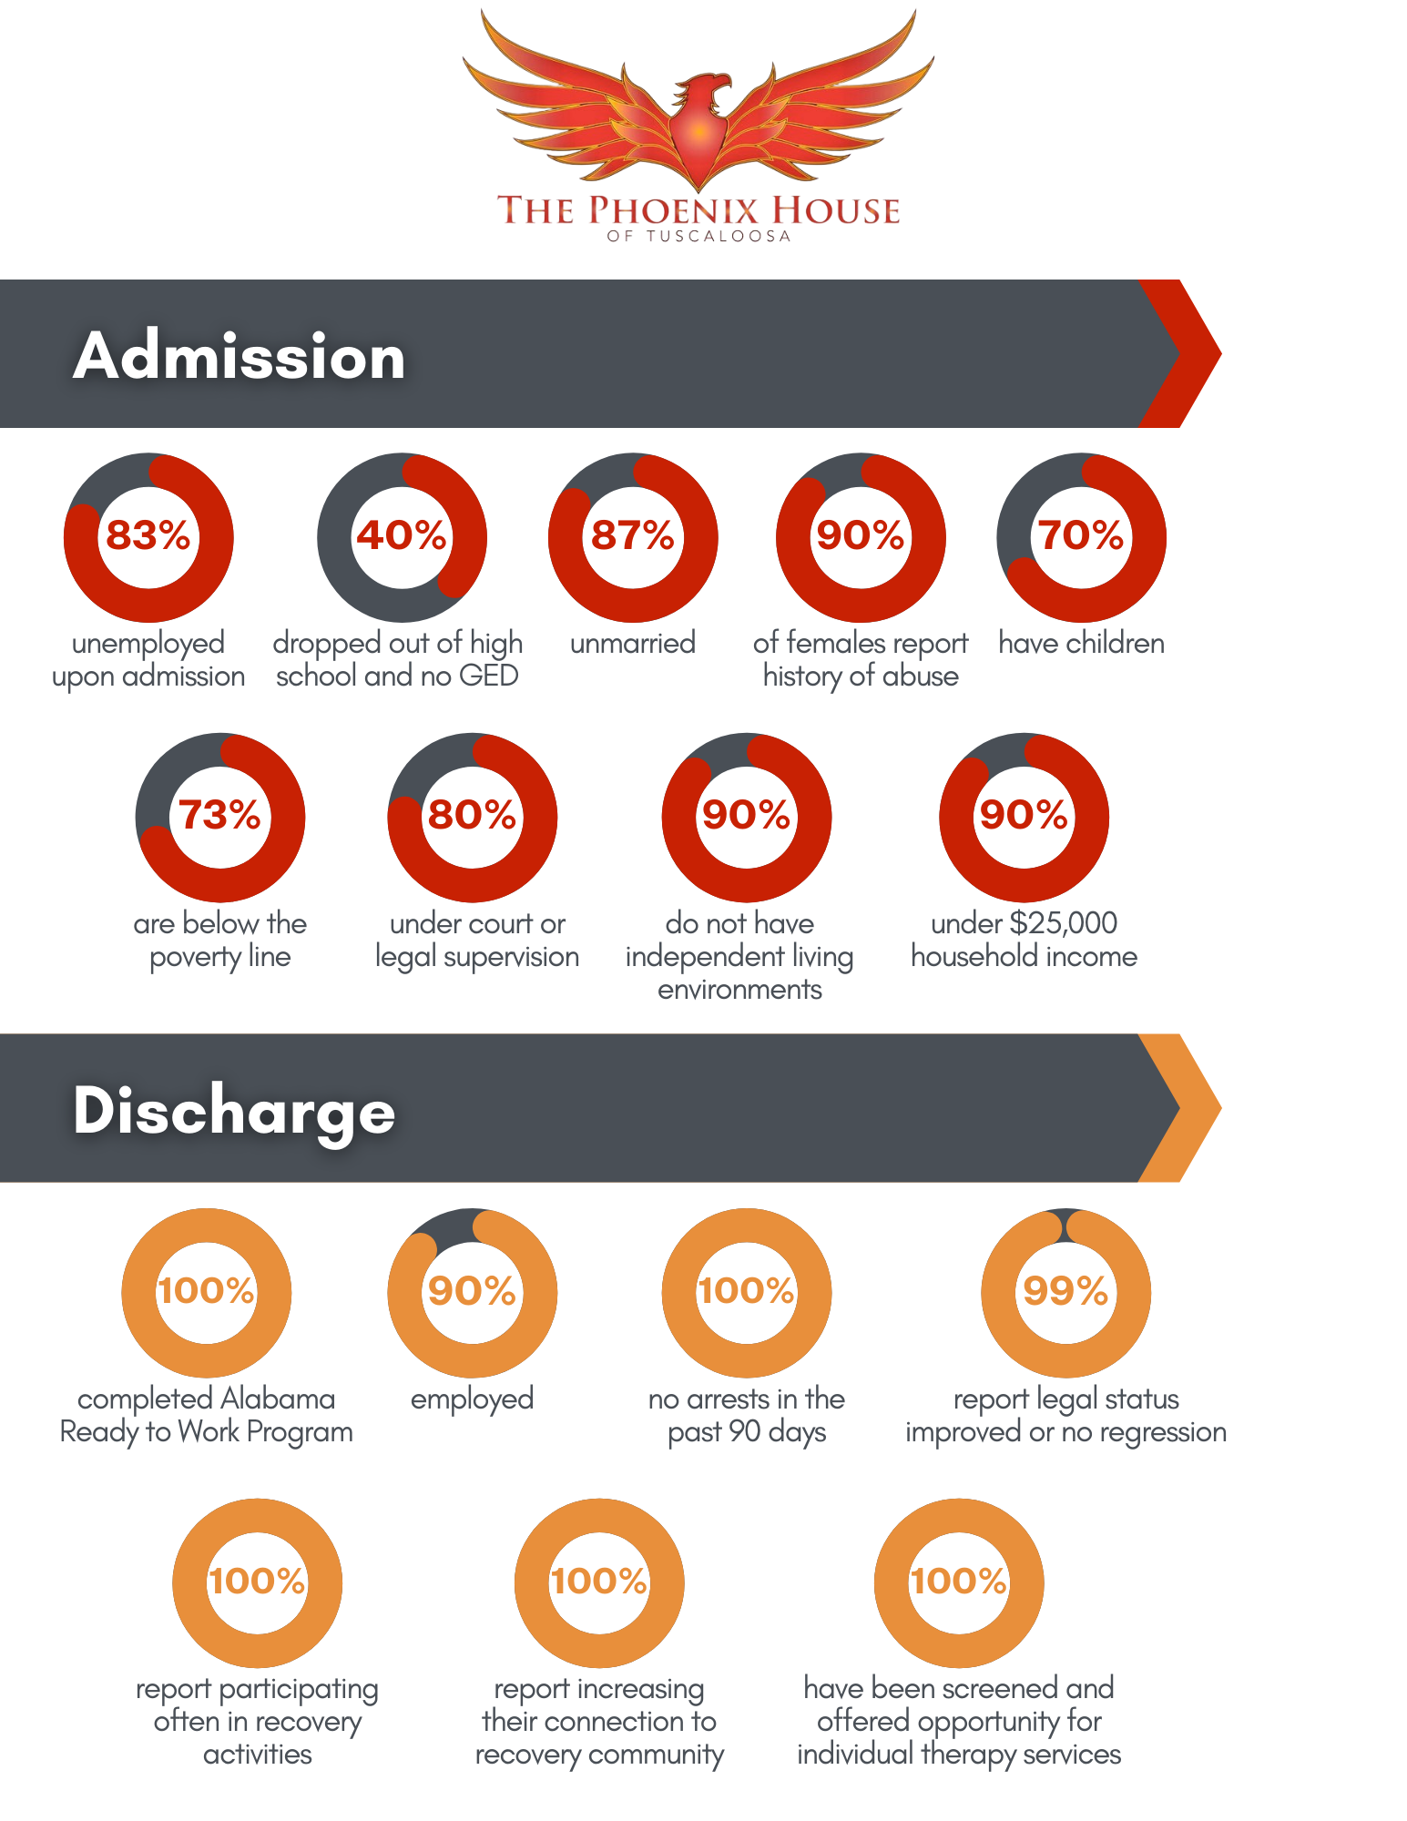

Slide 6
Time | Monday | Tuesday | Wednesday | Thursday | Friday | Saturday | Sunday
5:00 AM | Men's Wake Up | Men's Wake Up | Men's Wake Up | Men's Wake Up | Men's Wake Up | Mens Wake Up | Mens Wake Up
5:30 AM | Women Wake Up | Women Wake Up | Women Wake Up | Women Wake Up | Women Wake Up | Womens Wake Up | Womens Wake up
 | Med Call | Med Call | Med Call | Med Call | Med Call | Med Call | Med Call
6:00 AM | Med Call | Med Call | Med Call | Med Call | Med Call | Med Call | Med Call
 | Meditation | Meditation | Meditation | Meditation | Meditation | Meditation | Meditation
6:30 AM | Med Call Ends | Med Call Ends | Med Call Ends | Med Call Ends | Med Call Ends | Med Call Ends | Med Call Ends
 | Breakfast Available | from wake up till | 9:00 AM
7:30 AM | Day Education S1 | Day Education S1 | Day Education S1 | Day Education S1 | Day Education S1
8:00 AM | Rooms Secured | Rooms Secured | Rooms Secured | Rooms Secured | Rooms Secured
9:00 AM | Peer Group | Peer Group | Peer Group | Peer Group | Peer Group | Peer Group | Peer Group
10:00 AM | Day Grounds | Day Grounds | Day Grounds | Day Grounds | Day Grounds | Happy Hour AA
11:00 AM | Ladies Lunch | Ladies Lunch | Ladies Lunch | Ladies Lunch | Ladies Lunch | Ladies Lunch | Ladies Lunch
11:20 AM | Mens Lunch | Mens Lunch | Mens Lunch | Mens Lunch | Mens Lunch | Mens Lunch | Mens Lunch
11:30 AM | Med Call | Med Call | Med Call | Med Call | Med Call | Med Call | Med Call
12:00 PM | AA Club House | AA Club House | AA Club House | AA Club House | AA Club House | Sponsor AA
1:30 PM | Day Vol Details | Day Vol Details | Day Vol Details | Day Vol Details | Day Vol Details
2:30 PM
3:00 PM | Rooms Open | Rooms Open | Rooms Open | Rooms Open | Rooms Open/ STD
3:00 PM | Day Education S2 | Day Education S2 | Day Education S2 | Day Education S2 | Day Education S2
4:00 PM | Womens Dinner | Womens Dinner | Womens Dinner | Womens Dinner | Womens Dinner | Womens Dinner | Womens Dinner
4:20 PM | Mens Dinner | Mens Dinner | Mens Dinner | Mens Dinner | Mens Dinner | Mens Dinner | Mens Dinner
4:30 PM |  |  |  | Parenting Class
5:30 PM | Med Call | Med Call | Med Call | Med Call | Med Call | Med Call | Med Call
5:30 PM | Ready to Work | Ready to Work | Ready to Work
5:30 PM |  |  |  | House Meeting |  |  | Womens Group
6:00 PM | Peer Group | NA Meeting |  | M & F/M Peer Groups | Peer Group X 3 | Peer Group | NA Meeting
6:00 PM |  |  |  |  | Monthly Banking
6:30 PM |  |  | Peer 12 Step
7:00 PM |  |  |  |  | Speaker Meeting
7:30 PM
8:00 PM | Chores | Chores | Chores | Chores | Chores | Chores | Chores
10:30 PM | Lights Out | Lights Out | Lights Out | Lights Out |  |  | Lights Out
11:30 PM |  |  |  |  | Lights Out | Lights Out

Slide 7
Covid 19 policy
For fully vaccinated DROP the MASKS
Masks still required in the vehicles
Why? Close quarters with Non-Vaccinated
Clients NOT Vaccinated:
Still Ware Masks
Social Distance
Not eligible for passes
Not eligible for PIR
%:30 am temperature checks
If test positive:
5-day quarantine no symptoms
10-day quarantine with symptoms

